Slide 1
UVM Basis
Adapted from ARM Lecture
Nagesh Loke

Slide 2
Challenges of verifying complex systems
Processor development can take 100s of engineering years
Requires parallel developments across multiple sites
need large team to verify a processor
Typical method: divide and conquer, partition CPU into smaller units and verify them, then reuse checkers and stimului at a higher level
Reuse code to avoid duplication of work
integrate external IP
This requires rigorous planning, code structure, lockstep development, and standardization

Slide 3
Universal Verification Method
Benefits:
supports and provides framework for modular and layered verification components
Enables:
reuse
clear functional definition for each component
configuration of components to be used in a variety of contexts
maintained by Accellera committee
Fully open source code
training and support available

Slide 4
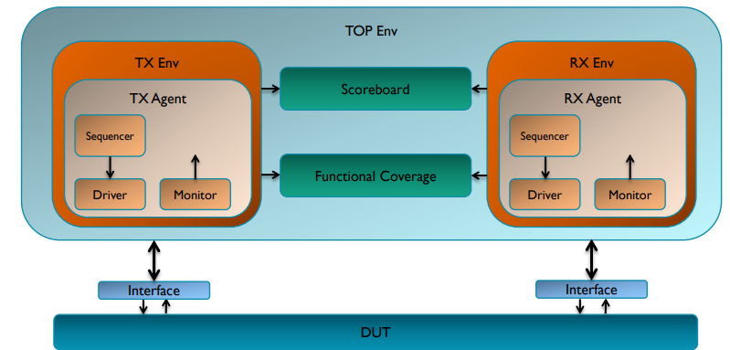
UVM Test Bench

Slide 5
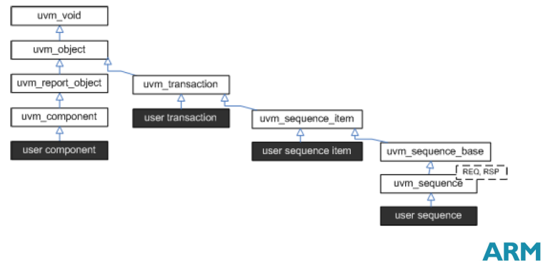
UVM Sequence & Genealogy

Slide 6
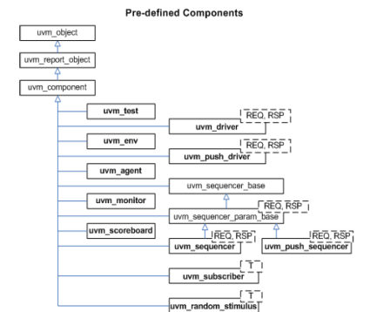
UVM Component
Building block of components that control testbench or transactions
Have time-consuming run() task
Exist for life of test

Slide 7
push_driver vs. driver??
push_driver waits until sequencer pushes a transaction into its port
Never initiates a transaction
Passively does what the sequencer tells it to
Rarely used, mainly for OVM backward compatibility
driver requests items to execute
Executes upon receipt
Tells sequencer when done, requests new item
Takes initiative

Slide 8
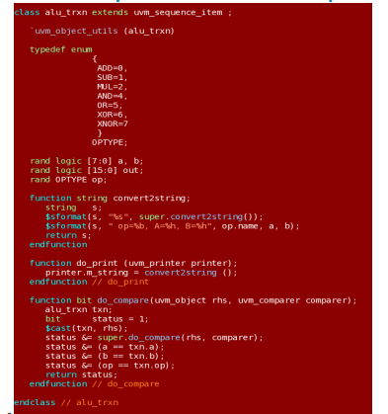
Sequence
Sequence item = transaction
Examples: packet, AXI transaction, pixel
Sequence = lit of sequence items
Sequence can be separated into a generator

Slide 9
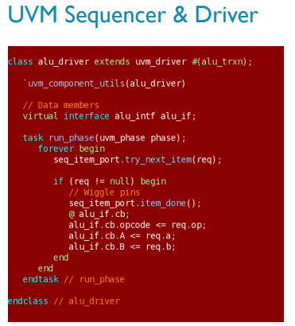
Sequencer vs Sequence
Sequencer sends transaction from sequence to driver
Sends driver response back to sequence
Can arbitrate among sequences (Salemi Ch 23)
Methods: send_request(), get_response()
Driver decodes transaction from sequencer
Drives DUT interface sinals
Pin-level protocol and timing relationships
(Here, cb probably denotes clocking block)

Slide 10
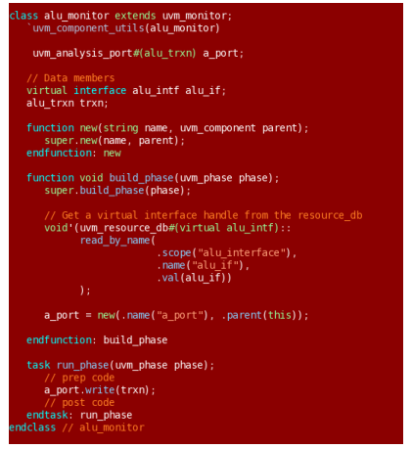
Monitor
Observes communications
Can check pin protocols
Creates transactions based on interface activity
Communicates using analysis ports

Slide 11
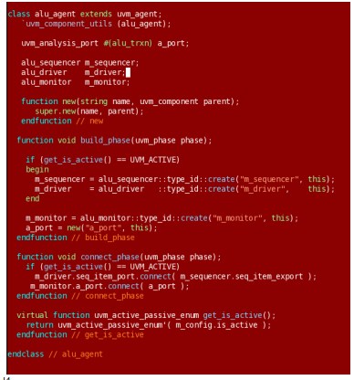
Agent
Connects sequencer, driver, monitor
Provides analysis ports
monitor to scoreboard & coverage
Can disable sequencer & driver

Slide 12
Scoreboard
Accepts transactions from monitors
Applies inputs to independent model & generates expected output
Compares actual vs. expected outputs
Queue of modeled outputs
Pops latest result when DUT output is available
Manages timing of inputs vs. outputs

Slide 13
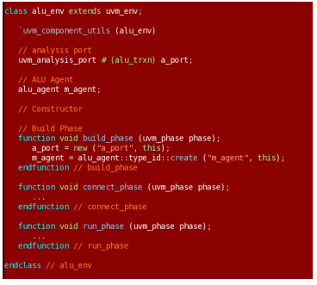
Environment
Manages components in testbench
Instantiates & connects:
agents
scoreboards
coverage modules

Slide 14
UVM Test
Creates environment
Controls types of tests to run
Configures components

Slide 15
TLM port
Mechanism to transport data or messages
SystemVerilog mailbox
Carries transaction
Analysis port for broadcast (one → many branching)
TLM port makes component more modular & reusable

Slide 16
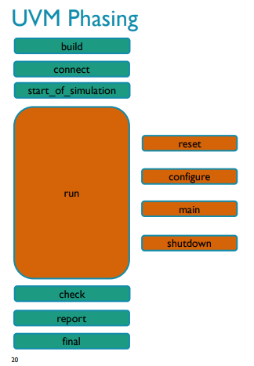
Phasing
Create components, allocate memory
Hook up (plumbing)
Print banners, topology, etc.
Reset DUT
Configure desigh
Run tests
Halt stimulus; drain transactions
End checks (objections dropped)
Report, pass/fail status
Complete test

